Slide 1
FarAway Epics
A 2D historic game

Slide 2
Character designs

Slide 3
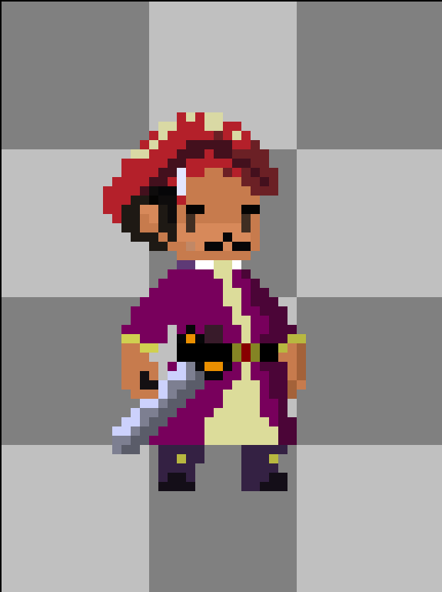
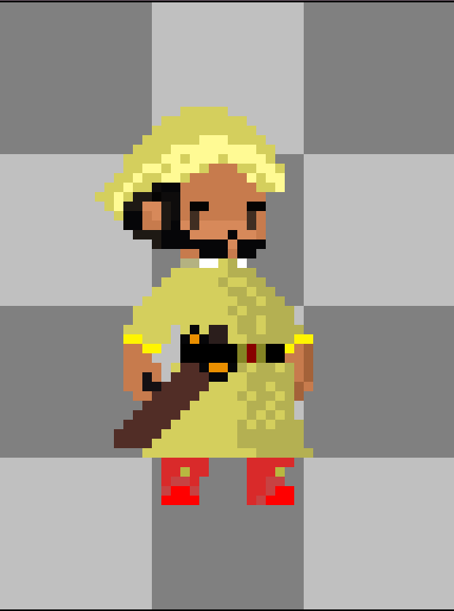
Bajirao
Chhatrasal

Slide 4
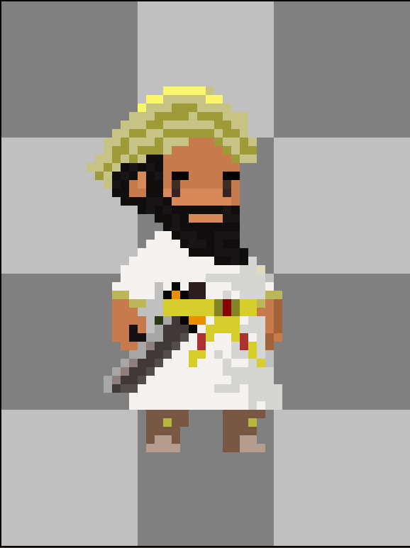
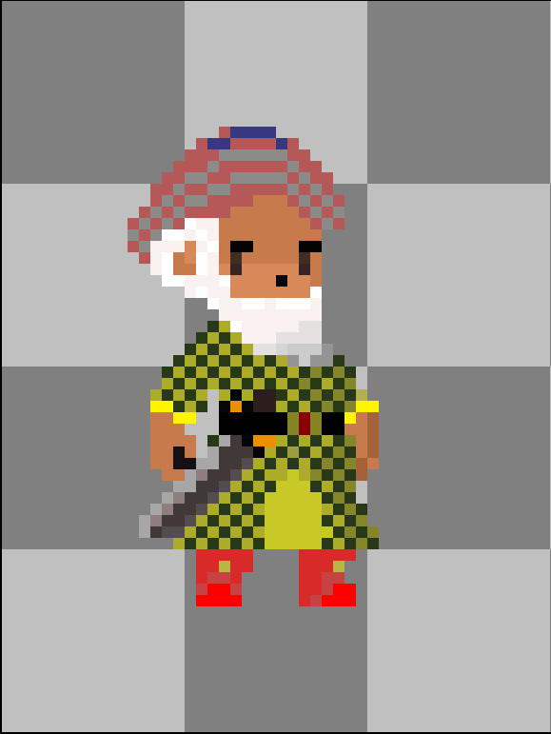
Mohammad Bangash
Nizam-ul-mulk

Slide 5
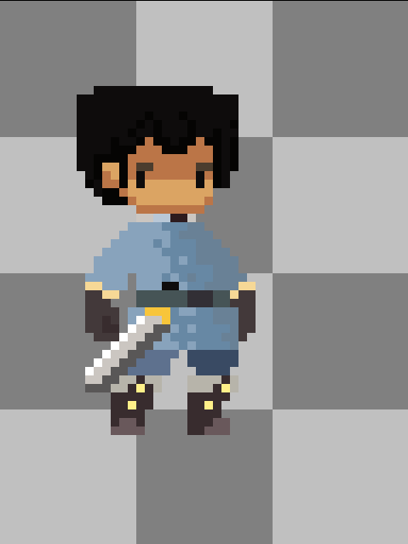
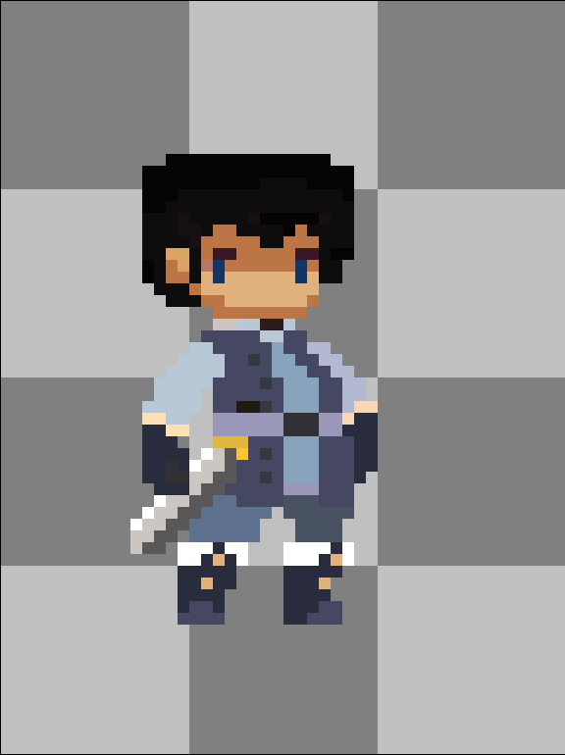
Soldier-1
Soldier-2

Slide 6
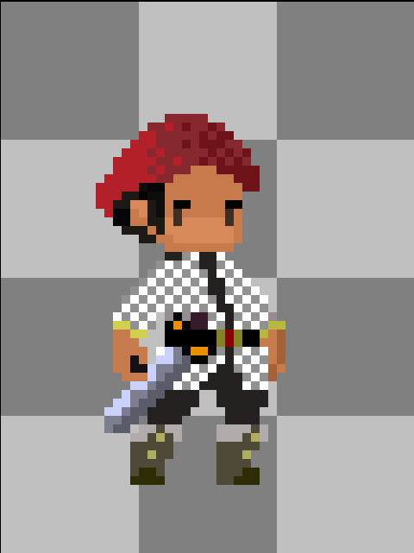
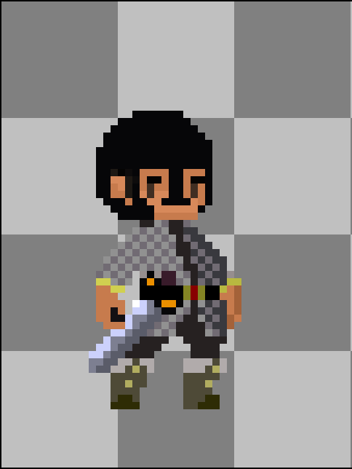
Soldier-3
Soldier-4

Slide 7
UI designs

Slide 8
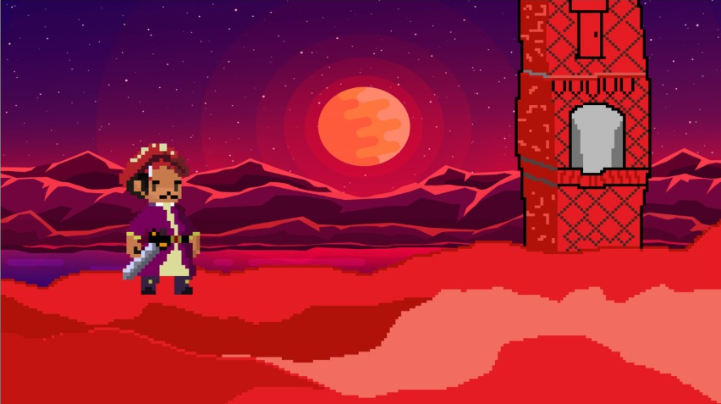
UI SLIDE-1

Slide 9
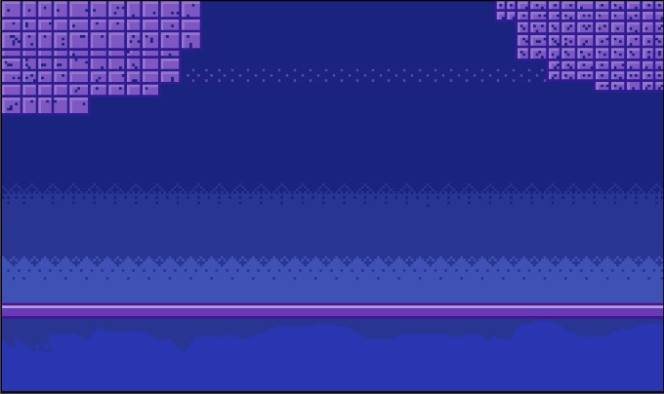
UI Slide-2

Slide 10
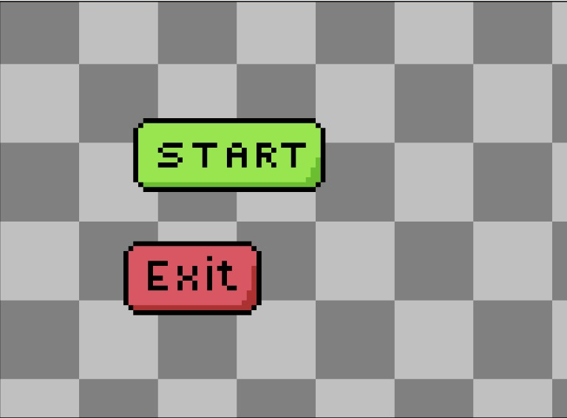
Start exit buttons set-1

Slide 11
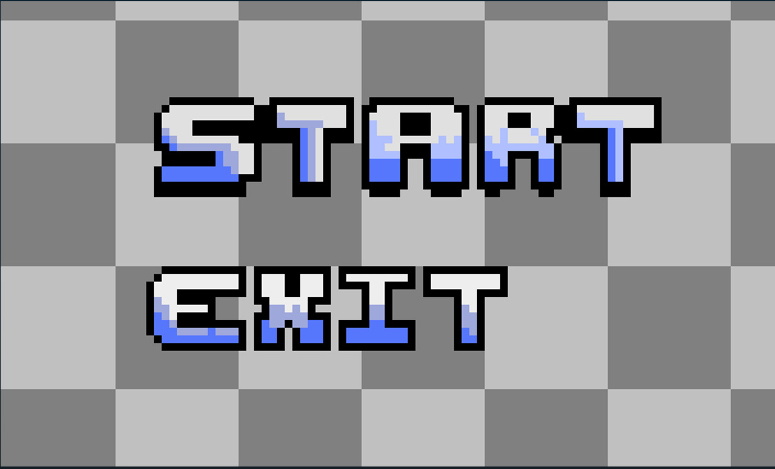
Start exit buttons set-2

Slide 12
Other designs

Slide 13
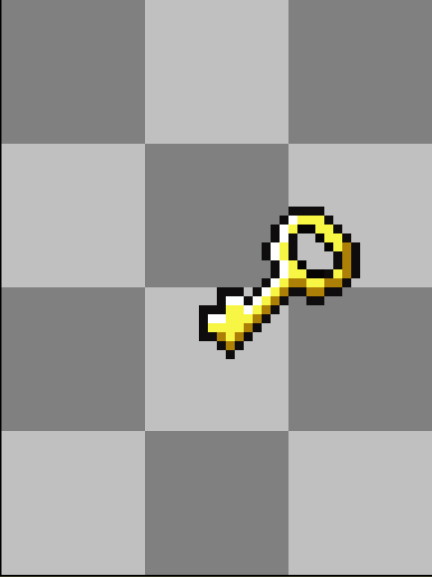
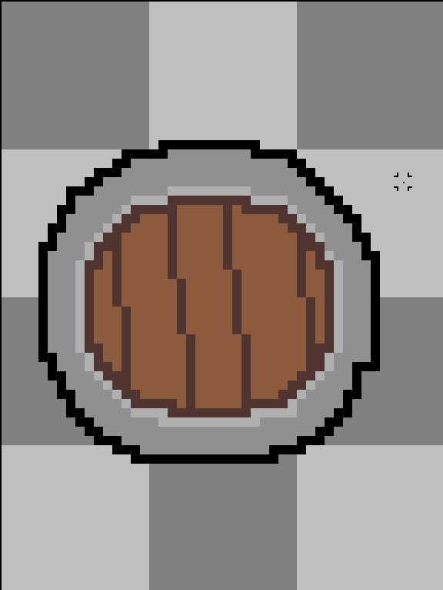
Key
Shield

